Slide 1
One world, everyone's responsibility
2020 NI Environmental Benchmarking Survey Webcast
www.bitcni.org.uk/NIEBS
SPONSORED BY
SUPPORTED BY

Slide 2
Webcast contents
Business in the Community
Survey Overview
Key dates
Resources
Changes for 2020
Survey website
Small Business Survey
Bring a Business
Scoring
Completing the Survey
Section 1: Corporate Strategy
Section 2: Environmental Management
Section 3: Environmental Performance
Section 4: Assurance
Top Tips
Help

Slide 3
What we do
WE SET A COURSE FOR RESPONSIBLE BUSINESS

Slide 4
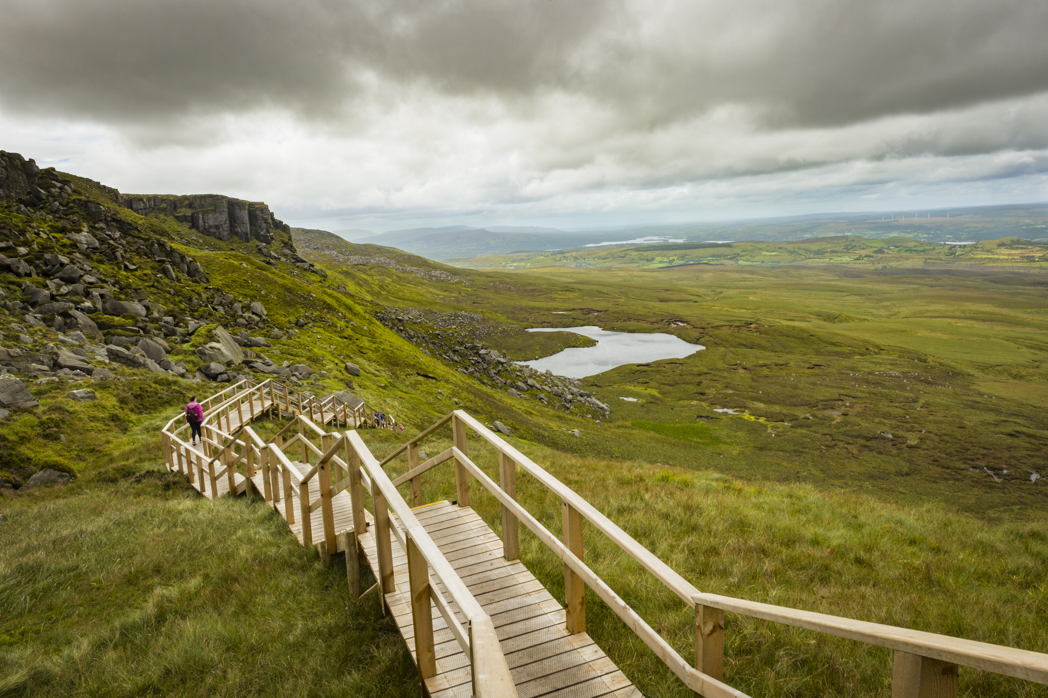
STEPPING UP
TO PROTECT
THE PLANET

Slide 6
Key dates
29 May
30 June
26 Nov
Deadline for informing BITC of your ‘Bring a Business’ nomination
Survey closes
2020 NI Environmental Benchmarking Survey results launch

Slide 7
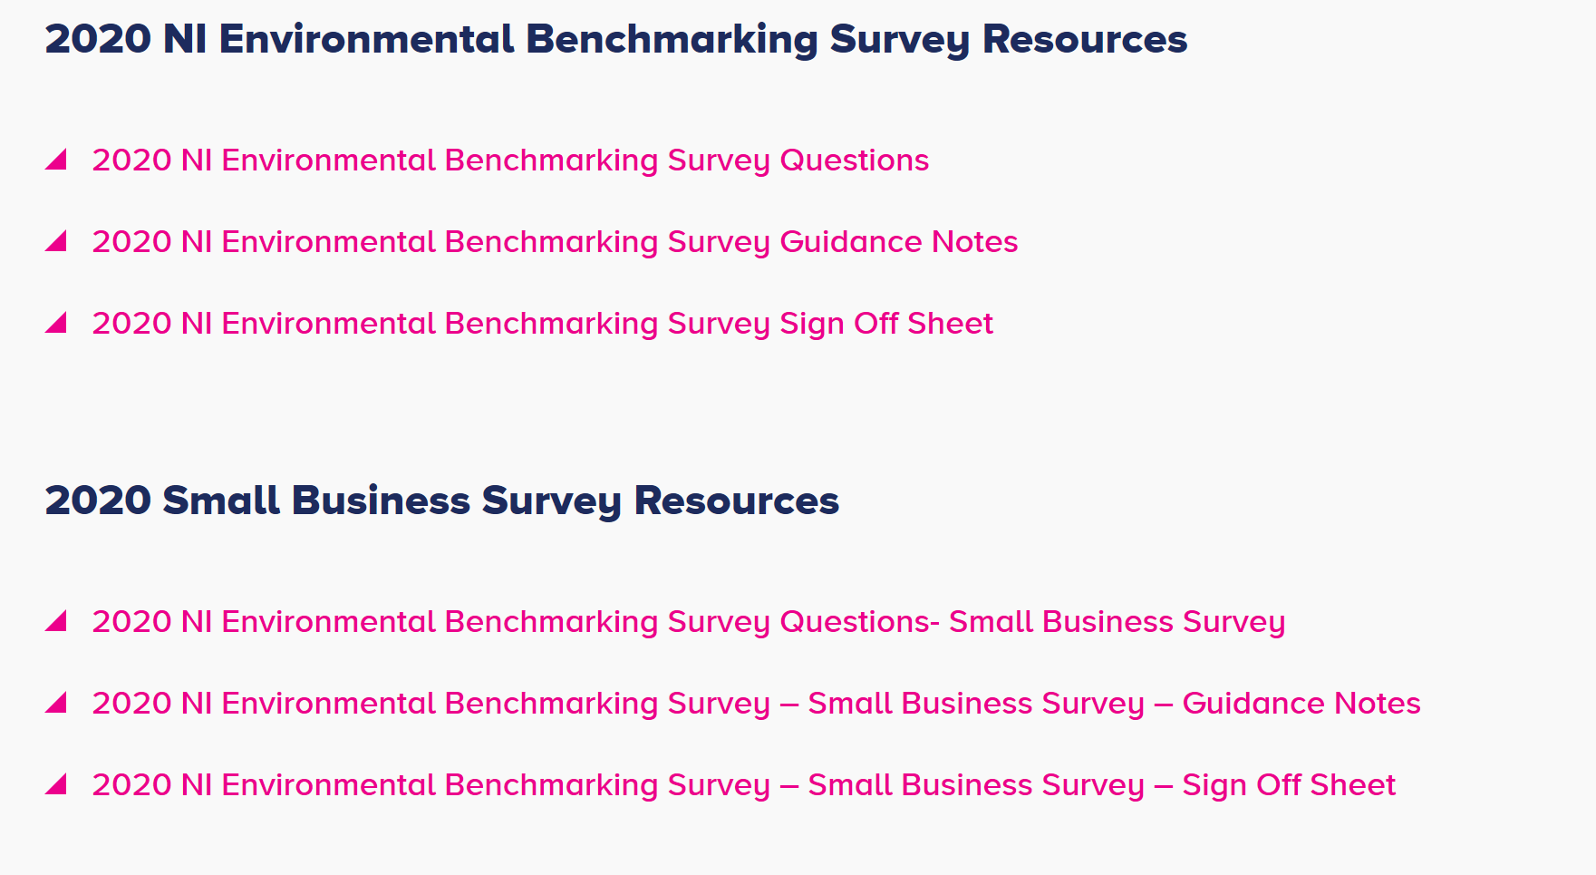
resources
www.bitcni.org.uk/niebs

Slide 8
changes for 2020
This year, through consultation with some of our main stakeholders, the following changes have been implemented:
Minor amendments
Climate Emergency Section
Unscored questions

Slide 9
Survey submission website
Your organisation’s unique link/token eg https://niebs.limequery.com/2020?token=TOKEN
Save and return later
Question help
Additional information

Slide 10
Small business survey
Open to organisations with less than 25 employees
Shortened version of main Survey
Award for top performing small business

Slide 11
Bring a business
Gain bonus points by ‘bringing a business’
Introducing another business to the Survey
For helping the business to complete the 2020 Survey
Mentoring relationship with the business

Slide 12
Scoring
Platinum (>90%)
Gold (80-89%)
Silver (60-79%)
Bronze (40-59%)
Green (<40%)

Slide 13
Sections in the Survey
There are four sections in the 2020 NI Environmental Benchmarking Survey
Corporate Strategy
Environmental Management
Environmental Performance
Assurance

Slide 14
Section 1: corporate strategy
Strategic Decision Making
Leadership
Stakeholder Engagement

Slide 15
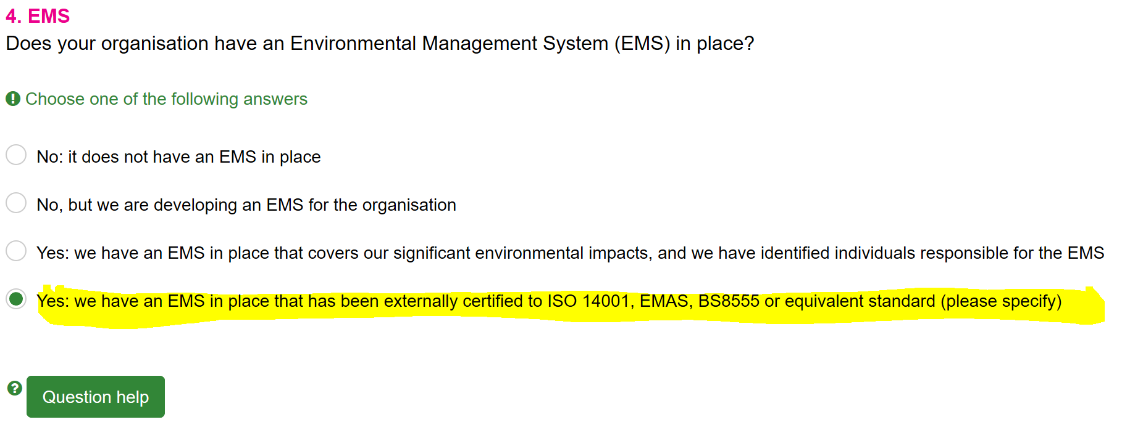
Section 2: environmental management
Environmental Management Systems
Policy
Issue
Register
Legislation
Objectives
Targets

Slide 16
Section 3: environmental performance
Climate Emergency
Greenhouse gas emissions
Circular Economy
Waste generated
Waste diverted from landfill
Water consumption
Additional Impact
Environmental Performance & Improvement SBS
Measuring and reporting
Scope and boundaries SBS
Data quality SBS
Taking action

Slide 17
specific questions
11. Climate Emergency
Renewable energy
Climate risk
Science-based targets (unscored) SBS
Energy storage (unscored) SBS
Carbon offsetting (unscored) SBS
12. Circular Economy
Environmental impacts

Slide 18
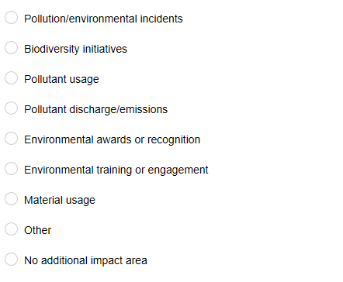
Additional impact

Slide 19
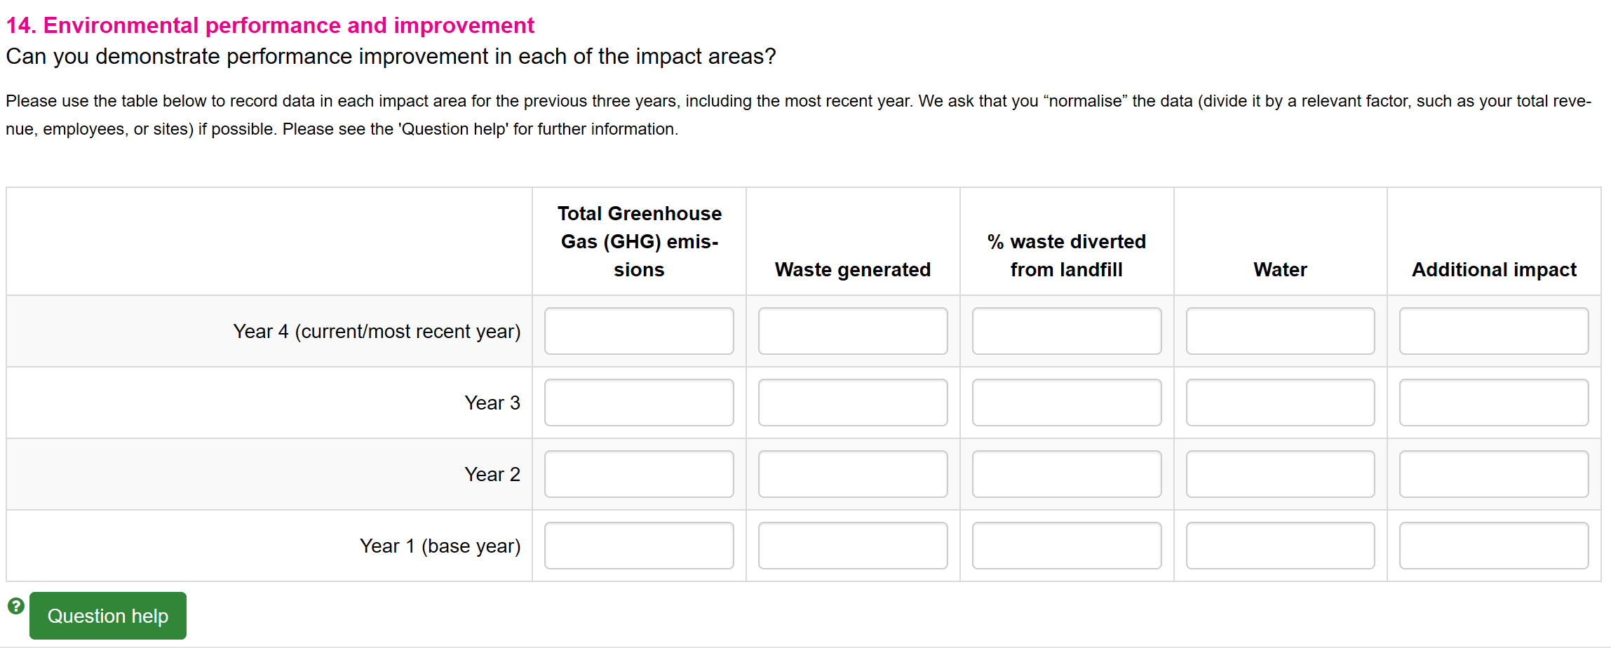
Performance data

Slide 20
Section 4: assurance
15. Assurance
Prosecution
Senior management sign off
Complete Survey

Slide 21
Top tips for completing the survey
Leave plenty of time
Don’t miss out on the extra points available for ‘Bring a Business’
Normalise data wherever possible
Focus on the most significant additional impact to your organisation
Contact BITC with any queries or issues completing the Survey

Slide 22
Need help?
Contact the environment team – environment@bitcni.org.uk
www.bitcni.org.uk/niebs

Slide 23
environment@bitcni.org.uk

